Slide 1
Value Analysis / Value Engineering
Information & Evaluation Phases Kaizen Event

Slide 2

Other Modules In This Series:
5S
Standard Work
Total Productive Maintenance (TPM)
Administrative Lean
Cell Design/ Production Preparation Process (3P)
Kaizen
Kanban
Problem Solving
Poka Yoke Quality Systems
Transaction Process Improvement (TPI)
Cause & Effect Diagram with the Additions of Cards (CEDAC)
Single Minute Exchange of Dies (SMED)
Value Stream Mapping (VSMi®)
Visual Management
Managing Daily Process Excellence
For More Information Please Contact:
Mark DeLuzio, President and CEO
+1.860.234.0915
mark.deluzio@leanhorizons.com
Strategically Creating Value Through the Elimination of Waste

Slide 3
This document contains confidential
and proprietary information owned
by Lean Horizons Consulting, LLC.
Any disclosure, use, copying or
distribution of this information without the express written consent of Lean Horizons Consulting is strictly prohibited.

Slide 4
Ground Rules for Event
Safety first (use personal protective equipment)
Active participation by all
Start and end on time
All electronic gadgets (phones, pagers, etc.) turned to “off” or “silent”
Computers to be used only when instructed
Keep an open mind to change
Don’t let “perfect” get in the way of “better”
Notes:
DO: Ask the group if they have any ground rules to add (capture them on chart paper).
Ask the group if they agree to these ground rules.
DO: Perform Group Introductions

Slide 5
VA/VE Roadmap
Goal of VA/VE Event:
Develop the lowest cost product without affecting quality or function with the shortest development leadtime
THIS EVENT
CONCEPT
EVALUATION
DESIGN
QUALIFICATION
RAMP-UP
Charter, baseline data, schedule
Generate ideas, evaluate , select, action plan
Specifications, detailed design, production process
Components, Customer
ECO (PCN), stock run-out, volume

Slide 6
VA/VE Methodology
INFORMATION
Selection
Content Detail
Function Detail
Identify Product, Component, System, or Service for Evaluation
BOM
Direct Cost
Indirect Cost
Functions & Performance, Specification, Regulatory Requirements
ANALYSIS
Process Detail
Define Value
Cost Analysis
Alternatives
Process Analysis
VOC
V = F /C
Cost Summary
Cost Cube:
Type of Cost
Cost to Whom
Cost When
Competitive Analysis
SELECTION
Brainstorming
Evaluation
Development
7 Alternatives
Function & Process Analysis
Cost Alternatives
Ease / Impact
Technical Process
Selection Matrix
Pugh Matrix
Alternative Refinement
Decision
Action Planning

Slide 7

Value Analysis / Value Engineering
Value Analysis – Typically existing product or service
Value Engineering – Typically new product or service
Value = Function / Cost
  Increasing performance if customer needs, wants, and willing to pay for more performance

Slide 8
What is the Difference between VA and VE?
VA – VALUE ANALYSIS
VE – VALUE ENGINEERING
Existing product or service
Manufacture, Aftersales
Process innovation
Unnecessary cost, Improvement performance
New product or service
Prototyping, Design or Pre-manufacture
Function breakthrough
Increase Value

Slide 9
What is the Difference between VA and VE?
Prototyping | Design | Pre-manufacture | Manufacture | Aftersales
VE
VA
VE/VA

Slide 10

Cost Analysis
Are Costs: Excessive, Quite High, Acceptable, or Cheap?
How costly is it compared to alternatives which achieve similar or greater value?

Slide 11
VA/VE Roadmap
THIS EVENT
CONCEPT
EVALUATION
DESIGN
QUALIFICATION
RAMP-UP
Charter, baseline data, schedule
Generate ideas, evaluate , select, action plan
Specifications, detailed design, production process
Components, Customer
ECO (PCN), stock run-out, volume
Confirm Charter and Review Information
Analysis of Current State
Generation of Alternatives
Evaluation of Alternatives
Activity Action Plan

Slide 12
VA/VE Kaizen Event
Charter & Information
Analysis of Current State
Generation of Alternatives
Evaluation of Alternatives
Activity Action Plan
Objectives:
Kaizen event preparation
Content Detail
Function Detail
Confirm project charter
Stakeholder management assessment
Notes:
DO: Review section objectives on slide.

Slide 13
Identify product/component/system or service
Charter & Information
Selection must be made by business need
  Safety
  Quality
  Delivery
  Cost
  Growth
Selection Hierarchy
  Strategy Deployment
  Strategic Value Matrix
  VOC
  Market Need
  ‘Inspired’ Business Need
  etc…
Typically VA – Existing Products
May be a combination of factors driving need
Typically VE – New Products

Slide 14
Strategic Value Matrix
Charter & Information
SKUs to monitor for changing profitability and marketability
May be candidates for rationalization if more profitable and/or strategic substitution can be made, or if product line is too “full”.
Core SKUs of the product line
Activities should focus on maintaining and improving position in the marketplace.
Product innovation and extension activities
Maintain & Monitor
Maintain & Grow
Profitability (%)
“Watch List”
Corporate Margin Target
Rationalize/Reposition
Evaluate
0%
Improve profitability for high “strategic value” SKUs
Modify/improve cost structure
Re-price
Maintain as tactical SKU
Substitute and eliminate
Candidates for rationalization / repositioning
Strategic Value
1
5

Slide 15
Gather Information – Example Data to Collect
Charter & Information
Part Data
Production Data
Part Numbers
Drawings
Samples
Specifications
Standards
Interfaces
Reliability
Costs – fixed and variable, direct and indirect, controllable
Process steps or maps
Process times
Changeover times/frequency
Volumes
Typical batch sizes
Quality (process outputs)
Takt time
Stock/WIP
Replenishment times
Layouts and people

Slide 16
Diagrams
Charter & Information
Points Description
1
Fishbone Diagram
6 M’s or critical factors
2
Process Layout
Sequence of build with components, and processes
3
Process Map
The whole system or sub-process
4
Exploded Assembly
Illustration of all assemblies
5
Design Diagram And System Hierarchy
The whole system and system hierarchy

Slide 17
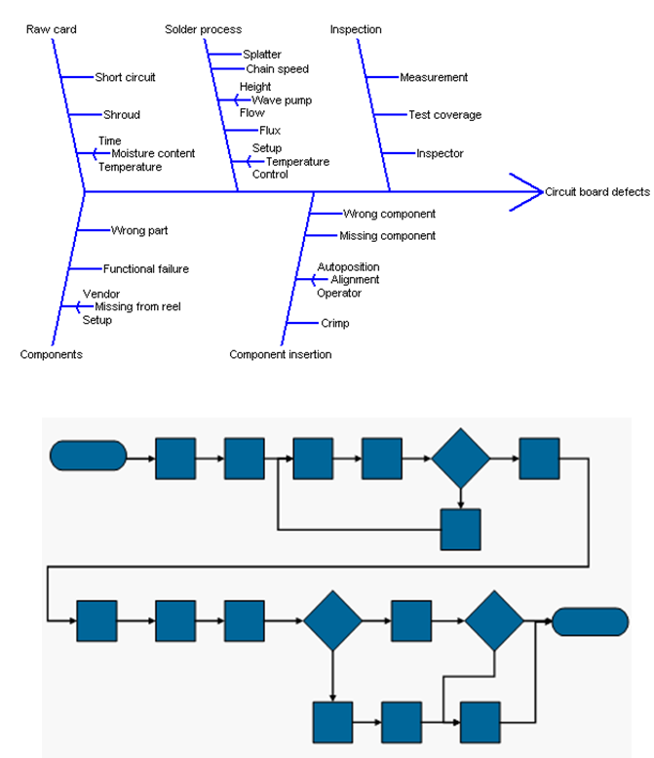
Fishbone and Process Map
Charter & Information
Determine the key functions of the process to be studied from the diagram(s)

Slide 18
Process Layout Example
Charter & Information
Operation Sequence
From:
Raw Material
STANDARD WORK SHEET
Part No.
123-A
To:
Assembly
Part Name:
Bracket
Tap
Drill
Mill
Raw
Material
+
+
+
Grind
5
4
3
2
1
6
+
7
Finished
Goods
Assembly
Test
Pack
Quality Check
Safety Precaution
Standard WIP
# Pieces WIP
TAKT Time
Cycle Time
+
4
77”
70”

Slide 19
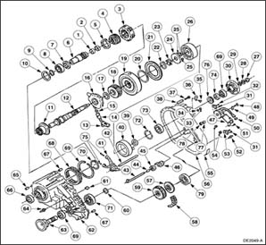
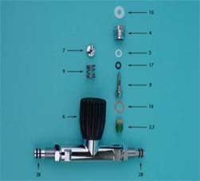
Exploded Assemblies
Charter & Information
Use drawings and exploded views to visualize product or process

Slide 20
Design Interrelationship Diagram Example
Charter & Information
Draw the relationship diagram of the product/process to the system
Show the number of inputs and outputs e.g. 1/3 input/output
Define the interfaces
Describe the requirements for each interface
1/3
2/1
1/2
1/2
3/0
Notes:
NOTE: Can use SIPOC (Supplier, Input, Product/Process, Output, Customer) analysis or other relationship definition. The objective is to understand and have data on how the product/process will interact with and fit with other systems, sub-systems and components/processes.

Slide 21
System Hierarchy
Charter & Information
Complete Product or Process
Major System A
Major System B
Major System C
Major System D
Sub-system/ Module B1
Sub-system/ Module B2
Sub-system/ Module B3
Sub-assy B1.1
Sub-assy B1.2
Sub-assy B1.3
Sub-assy B1.4
Sub-assy B1.5
Comp. B1.4.1
Comp. B1.4.1
Comp. B1.4.1
Comp. B1.4.1
Comp. B1.4.1
Understand the system architecture and define the relationship of the product/process to be Leaned as a part of the total system

Slide 22
Product and Process Information
Charter & Information
Objective
To gather and understand the product and process information and how they interface to other products and systems
Instructions
Time to Complete
Gather product and process information.
Draw the System architecture and hierarchy and detail the product/process.
Develop a Relationship Diagram or similar to define the interfaces.
Summarize the key elements and interfaces.
Provided by facilitator
Deliverable
Capture your summary in a presentable format.

Slide 23

Forming the Team - Team Make Up
Charter & Information
Size
Authority and Responsibility
Roles
Age
Mandatory/Voluntary?
Skills
Notes:
Size usually 4 to 12 - 8 ideal but depends on size of problem
Define authority and responsibilities i.e. give direction but scope to act as necessary
Roles can be: gathering data, making jigs and fixtures, communicating with customer
Age: a mix works well
Mandatory/voluntary: sell the benefits and need for expertise. Make it a desirable thing to join a team
Skills: Use a multi-disciplined group with appropriate skills for the job but throw in a couple of ‘wild cards’ to offer another perspective and for self development

Slide 24

Describe & Quantify the Problem - Project Charter
Charter & Information
Typical Project Charter contains:
  Background to problem or reason for project
  Sketch or photo of problem
  In Scope / Out Scope
  Problem definition
  Goal statement
PROJECT CHARTER
Background
Sketch / Photo of Problem
In Scope / Out Scope
Problem Definition
Goal Statement
Notes:
DO: Describe the slide. Refer to the Problem Solving Worksheet.doc and the appropriate page in the A3 Reports.doc as examples of a project charter format. Point out the other elements of a project charter could be the team members, project deliverables, the metric(s) you will use to show improvement, an overview of the project plan etc.

Slide 25


Stakeholder Management
Charter & Information
Identify project stakeholders (individuals or groups)
Define the current level of support & influence for each stakeholder
Define an influencing strategy to deliver and sustain the necessary stakeholder support
Create action and communications plans
Notes:
SAY: Stakeholder management is about identifying who the project stakeholders are and managing their level of support to be favourable for the project.

Slide 26
VA/VE Kaizen Event
Charter & Information
Analysis of Current State
Generation of Alternatives
Evaluation of Alternatives
Activity Action Plan
Objectives:
Process detail analysis
Define value & understand Voice of Customer
Cost analysis
Competitive analysis
Notes:
DO: Review section objectives on slide.

Slide 27
Understand the Interconnections of your Process - SIPOC
Analysis of Current State
S | I | P | O | C
Suppliers | Inputs | Process | Outputs | Customers
2. Start
6. Who is the supplier of each input?
5. What Inputs are required to enable this process to occur?
1. What is the process?
3. What are the outputs from the process?
4. Who is the customer of each output?
2. End
Notes:
SAY: “A SIPOC can help the team to quickly get an overview of the process including the outputs and inputs and the process’ customers and suppliers.”

Slide 28

Value Stream Map and Process Map Distinction
Analysis of Current State
Detailed graphical depiction of a manufacturing or business process
Used to identify specific improvements
Incorporates decision loops within the
process
VALUE STREAM MAP
I
I
High-level snapshot of end-to-end business
Used to identify where opportunities for
improvement exist
Does not incorporate decision loops
Notes:
SAY: “A Value Stream Map is the “30,000-foot” view of the process. A Process Map is a tool that would take just one process box from a Value Stream Map, and explode that process into it’s detailed steps.
SAY (regarding differences between Process Mapping and VSM): “Process Maps do not show information flow nor do they look at people. Process Maps are focused more on settings and/or materials. Value Stream Maps look at the people in the process. With VSM there is a heavy emphasis on identifying and removing waste. In VSM we ultimately want to reduce Lead Time. Process Mapping does not look at Lead Time.”

Slide 29
Value Stream Map
Analysis of Current State
Business Level VSM
Highlighting Project Opportunities
Mike’s Metal Enclosures (MME)
30/60/90
Forecast
Weekly
Fax
Production Control
Demand = 30,000 Enclosures/month
1 Shift
Acme
Sheet Metal Co.
Monthly P.O.
(Faxed)
Daily Orders
(EDI)
Ed’s Electrical Supply
MRP
System
Takt Time
27,000 Seconds
1,500 Pieces
= 18 seconds
1X
Week
Weekly Build
Schedule
(Paper)
Weekly Build
Schedule
(Paper)
Weekly Build
Schedule
Paper
Daily
Daily Ship
Schedule
(Paper)
Cut
Stamp
Brake Form
Ship
I
I
I
I
= 5
= 1
= 1
3,200 Sheets
Reduce
Manpower
5,250 Pieces
9,300 Pieces
2,300 Enclosures
Improve
DOI
1 sheet yields 4 pieces
DOI = 12”
C/O Time = 30’
Uptime = 99%
Quality = 99%
5 Machines
DOI = 15”
C/O Time = 30’
Uptime = 99%
Quality = 98%
DOI = 20”
C/O Time = 120’
Uptime = 99%
Quality = 85%
1 pc Flow
Improve
Quality
8.5 days
3.5 days
6.2 days
1.5 days
Production L.T. = 19.7 days
Processing Time = 275 seconds
240 sec
15 sec
20 sec

Slide 30
Mapping the Current Process
Analysis of Current State
Input
Flowchart
To understand the process involved in the problem situation as it exists today use a flowchart to document the steps
Since the problem and solution both affect a supplier and customer, be sure they are represented on the problem solving team
Process
Decision
No
Yes
Output
Notes:
SAY: “These are the basic elements of a process flow chart.”

Slide 31
Example Process Mapping Symbols
Analysis of Current State
Operation
A Step in the process
that adds value.
Transportation
To move from one place to
another. (Not part of an
operation or inspection.
Measurement
To inspect, verify, count,
examine, gage for quality
or quantity.
Transmission
To send information by
electronic means.
Storage
To hold for later use.
(I.e., in a queue).
Decision
A step in the process where
a change in the flow may
occur.
Delay
To wait for the next operation.
(I.e., in a queue).
No value added.

Slide 32
Mapping the Process
Analysis of Current State
Objective
To map the product Value Stream and Key processes.
Instructions
Time to Complete
Walk the process and list all the steps.
Layout the steps using Post-It notes.
Check all steps are included.
Walk the process and capture the information.
Mark the information on the map.
Check for sufficiency and logic.
Provided by facilitator
Deliverable
Capture your summary in a presentable format.

Slide 33

Voice Of Customer
Analysis of Current State
Listening to customer needs and wants (external & internal)
Internal feedback
  Engineering Change log
  Concession notes
  Cost of Quality
Customer feedback
  surveys
  feedback forms
  focus groups
Specifications
Standards

Slide 34
Quality Function Deployment
Analysis of Current State
Conflicts
List “What” the customer needs are and ratings
Decide “How” the needs will be met (Design Features) and their measures “How Much”
Determine the relationships
Calculate importance ratings What’s to How’s via Relationships scores
Benchmark current performance by plotting relative positions
Set targets
Identify Conflicts in the How’s
Identify Conflicts in the Relationships between Benchmarks
Strong Pos
Positive
Negative
Strong Neg
Design Features
“How”
Relationships
Customer Needs
“What”
Ratings
Benchmarks
Importance Rating
= 1 Weak
= 3 Medium
= 9 Strong
Measures
“How Much”
Benchmarks
Targets

Slide 35
Quality Function Deployment
Analysis of Current State
Design Features
Part Characteristics
Customer Needs
Production
Requirements
Design Features
Supply
Requirements
Part Characteristics
Production Requirements
Translating Customer Inputs to Business Outputs

Slide 36
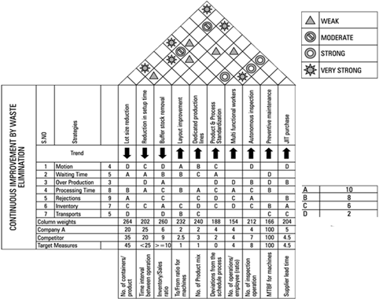
QFD Architecture Example
Analysis of Current State

Slide 37
What is Value?
Analysis of Current State
A product or service is generally considered to have good value if that product or service has appropriate Function (performance) and Cost
Value increases when costs decrease, while maintaining performance
Value increases when performance improves if the customer needs and wants and is willing to pay for it
⬆
Function
⬆
Value =
Cost
➔
➔
Function
⬆
Value =
Cost
⬇
Function
⬆
Value =
⬆
Cost
⬇
Function
⬆
Value =
⬇
Cost
⬇
Function
⬆
⬆
Value =
⬆
Cost

Slide 38

What is Function?
Analysis of Current State
The basic purpose of each cost, whether it be for hardware, the work of a group of people, a procedure, is to accomplish a function.

Slide 39

Different Functions
Analysis of Current State
Use of function
Aesthetic function
Basic function
Secondary function

Slide 40

Function Analysis
Analysis of Current State
Identify Functions
Characterize Functions
  “Must Have”
  “Nice to Have”
For Each Function, list all alternative means to achieve the Function

Slide 41
Develop a Broad Definition of the Function
Analysis of Current State
Broad
Narrow
Reduce speed by X:Y
Secure A & B for XYZ loading
Move material from A → B
Raise X Kg Y m high
Protect electronics from environment
Gearing ratio X:Y
Bolt A to B with D dia fasteners
Fill bins & transport X per pallet
Crane X Kg SWL load Y m lift
Electrical cabinet

Slide 42
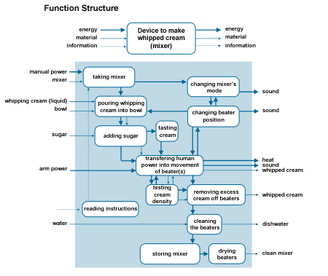
Function Analysis
Analysis of Current State
Method for analyzing and developing a function structure
Function structure is an abstract model of the new product
Describes the functions of the product and its parts and indicates the mutual relations
Thinking about the product in an abstract way stimulates creativity, and prevents you from ‘jumping to solutions’

Slide 43

Identify key words for each function
Analysis of Current State
Guide
Clamp
Swivel
Oscillate
Lock
Rigidity
Spin
Press
Bond
Turn
Roll
Brake
Drill
Shear
Fasten
Slide
KEY WORDS

Slide 44
Exercise: Determine Function
Analysis of Current State
Objective
Determine key functions.
Instructions
Time to Complete
Using the example provided on the following page, determine the key functions for the product.
Determine customer needs.
Answer: how does it add value to the customer?
15 minutes
Deliverable
Report out key functions, value added, and customer needs.

Slide 45
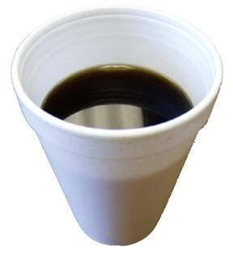
Define Function Exercise
Analysis of Current State
How would you describe the product: Styrofoam cup
What does it do? List the customer needs. Name the features or characteristics. How does it add value to the customer?
Verb-Noun Functions
Notes:
NOTE:
Features include: convex interior, ridge for stacking, base, cup walls
Functions include: hold liquid, stack cup, insulate liquid, lift base, etc
Verb = action = hold, stack, insulate…
Noun = name of feature = liquid, cup, base…

Slide 46
Determine Product Functions
Analysis of Current State
Objective
Determine key product functions.
Instructions
Time to Complete
Develop a function structure.
Select the key functions.
Describe the key functions of the product.
Evaluate key functions for cost and technical performance.
Provided by facilitator
Deliverable
Report out key functions, value added, and customer needs.

Slide 47
Cost Analysis
Analysis of Current State
Using the output of the Function Analysis:
Determine the cost of each function
  Refer to your BOM, Direct Costs, Indirect Costs from the Information Phase
  Populate a Cost Cube (optional)
    A useful tool for making sure all important costs are considered, especially non-monetary costs
For each Function, list all alternative means to achieve the Function
  Estimate the costs of each alternative mean

Slide 48
Cost Analysis
Analysis of Current State
Using the output of the Function Analysis:
Are the Costs?
  Excessive
  Quite High
  Acceptable
  Cheap
How costly is it to deliver each current functional outcome compared to the alternatives?

Slide 49
Cost Analysis
Analysis of Current State
Using the output of the Function Analysis:
Select the Functional options which Deliver the best Value
Focus on maximizing Value!
Remember, there are several types of Cost, not just Monetary Cost
  Types of cost
    Monetary
    Time
    Effort
    Space
    Opportunity
Function
Value =
Cost

Slide 50
Alternative Solutions for each Function
Analysis of Current State
# | Solution Function | 1 | 2 | 3 | n
1 | Function 1 | Solution 1 | Solution 2 | Solution 3 | Solution n
2 | Function 2 | Solution 1 | Solution 2
3 | Function 3 | Solution 1 | Solution 2 | Solution 3 | Solution n
4 | Function 4 | Solution 1 | Solution 2 | Solution 3 | Solution n
n | Function n | Solution 1 | Solution 2 | Solution 3
Known as a morphological matrix

Slide 51
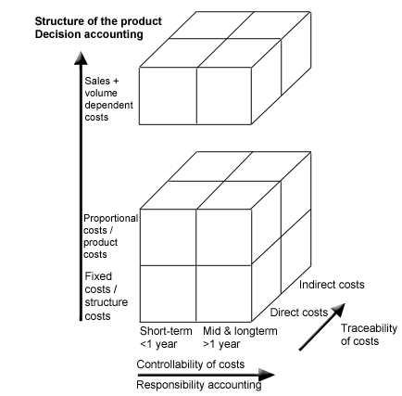
Cost Cube
Analysis of Current State
A Cost Cube can be a useful tool for making sure all important costs are considered:
When: cost controllability in the short, medium and long term (horizontal or x axis)
Type: fixed, variable/ proportional etc. costs (vertical or y axis)
Who: direct and indirect costs (3rd dimension or z axis)

Slide 52
Cost Cube Construction
Analysis of Current State
A Cost Cube considers three dimensions of cost:
  Costs When
    Costs may be incurred at different times. Such as phases of a construction project, or New Product Development project
  Types of Cost
    Monetary, Time, Effort, Space, Opportunity
  Costs to Whom
    Not all ‘to whom’ parties in a cost cube will incur each type of cost, therefore there may not be a cost element in the cube

Slide 53
Cost Cube Example: New Product Development Project
Analysis of Current State
Cost When
Cost Type
Cost to Whom
Design
Prototype
Production Process Design
Production Ramp-up
Go to Market
Money
Engineering Resources
R&D Lab Time
Marketing Resources
Factory Space
Opportunity Cost
Corp SG&A
R&D
Marketing
Operations
Distribution
Sales Channel

Slide 54
Exercise: Cost Cube Exercise
Analysis of Current State
Objective
Create a Cost Cube for a Styrofoam Cup
Instructions
Time to Complete
Using Post-It Notes, Develop a matrix of all costs involved in the design and manufacture of Styrofoam cups
Types of Cost
Costs When
Costs to Whom
Provided by facilitator
Deliverable
Comprehensive matrix which considers all types of cost associated with this example project.
Notes:
Begin the exercise considering the different TYPES OF COST:
Types of Cost: Monetary, Time, Effort, Space, Opportunity
Continue when considering WHEN the costs will be incurred:
Project Selection, Market Research, Design, Prototype, Mfg Ramp-Up, etc.
The final step is brainstorming WHO will incur the different costs and WHEN.
It may be useful to do a SIPOC or RACI to establish all stakeholders in a process to consider.
Corp SG&A
R&D
Marketing
Operations
Distribution
Sales Channel
End User
Etc…

Slide 55
Exercise: Cost and Alternatives Selection
Analysis of Current State
Objective
Determine Cost for Functionality and for Alternatives Means of Achieving Key Functionality
Instructions
Time to Complete
Determine the cost of each function
For Each Function, list all alternative means to achieve the Function
Estimate the cost of each alternative means
Select the Functional Options which Deliver the best Value
Provided by facilitator
Deliverable
Report out selected alternatives which optimize value.

Slide 56

Competitive Analysis
Analysis of Current State
Identify all critical competitive alternatives to your solutions
Complete a Value Analysis for Functionality and Cost
Are the Competitive Costs?
  Excessive
  Quite High
  Acceptable
  Cheap

Slide 57
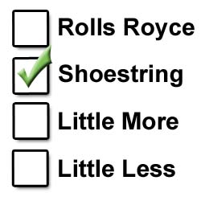
Competitive Analysis
Analysis of Current State
Consider the alternatives in four broad categories:
The “Rolls Royce” – what is widely regarded as best practice, or state of the art.
The “Shoestring” – a creative low-budget option
“A Little More” – an option that is marginally better
“A Little Less” – a slightly stripped down, or economical version

Slide 58

Competitive Analysis
Analysis of Current State
Comparative Cost-Effectiveness
The Cost Cube provides a three-dimensional tool for identifying important descriptive data
The list of competitive alternatives allow us to place the costs in the context of what else is available
We are then able to perform a merit determination for selecting our options

Slide 59
Determine Cost & Competitive Analysis
Analysis of Current State
Objective
Determine the cost and competitive analysis for your items.
Instructions
Time to Complete
Complete the cost cube and competitive analysis for this event.
Provided by facilitator
Deliverable
Cost & competitive analysis

Slide 60
VA/VE Kaizen Event
Charter & Information
Analysis of Current State
Generation of Alternatives
Evaluation of Alternatives
Activity Action Plan
Objectives:
Brainstorming
Affinity diagram
7 Alternatives
Function & Process Analysis
Notes:
DO: Review section objectives on slide.

Slide 61
Thinking Outside The Box
Generation of Alternatives
Objective
Stimulate the team to think laterally about solutions.
Instructions
Time to Complete
Join the Dots using 4 straight lines and without taking the pen off the paper.
10 minutes
Deliverable
Review how this has parallels to creative design.
Notes:
DO: Use blank paper and get the participants to make their own Dot matrix and solve the puzzles.
Give the participants 2 minutes to try to join the dots with 4 lines.
Then reveal the answer. Reinforce the idea of thinking outside the ‘self limiting’ box in order to get a solution.
Then ask how they could do it with 3 lines.
Reveal the answer as a ‘Z’ touching the top of the first dot of the first row, the middle of the second dot and the bottom of the third dot and extending as far as required to Z back to the middle and bottom rows.
Finally ask how it could be done with 1 line?
Reveal the answer as, if the dots were on a ball or the Earth and the line went all the way round and touched the dots in a helix as in the Z method above.
Alternatively one thick line could touch all dots.

Slide 62

Determine Potential Solutions
Generation of Alternatives
This phase of the problem solving process is about generating potential solutions
Several potential alternatives should be considered
Not considering a number of solutions could lead to jumping to a suboptimal or ‘pet’ solution
Several sources and tools can be used to generate potential solutions

Slide 63
Potential Sources for Solutions
Generation of Alternatives
Competitors
  Copy, adapt and improve
Other industries
  Food vs. process
  Auto vs. Aero
Inventive Problem Solving TRIZ
Pattern Breaking tools
  Reverse assumptions, forcing associations, making comparisons, other points of view, blue sky
Back to nature solutions
Study the way others have solved things and list the key words for each function
Solve design conflicts
Generate new ideas

Slide 64

Designing Out Cost
Generation of Alternatives
Costs must be designed out of a product
Removing costs after the product has been designed is very difficult
Design for the total supply chain and lifetime cost
Focus on the cost to the customer

Slide 65
Eight Cost Reduction Strategies
Generation of Alternatives
Design Cost
  design cost is 80% incurred but only 8% spent. Use more time and resources to reduce design cost. Concurrent engineering.
Lean Production Cost
  eliminate waste, cut throughput times and improve quality, design for manufacturability, 3P.
Overhead Cost
  build to order and reduce inventory.
Standardization
  use standard parts, get economies of scale, reduce inventory cost, reduce purchasing overhead cost, reduce manufacturing cost, free up time for other cost down activities .
Product Line Rationalization
  use current products or off the shelf products with modifications, simplify supply chain management
Supply Chain Cost
  co-locate suppliers, pre-select suppliers, avoid outsourcing for cost, avoid long supply chains and low-bidding
Quality Cost
  cost of quality can be 25-45% of cost, avoid past mistakes, clearly define the requirement, design in quality – Poka Yoke, select quality parts, simplify.
Total Cost Management
  measure and manage cost drivers.

Slide 66
Brainstorming Phases
Generation of Alternatives
Ideas
Initial ideas
Incubation period
Creative ideas
Phase 1
Phase 2
Phase 3
Time
Brainstorm to rebellion!
Notes:
DO: Explain the three phases of Brainstorming; 1) the initial ‘brain dump’, 2) incubation, 3) creative ideas

Slide 67

Rules for Brainstorming
Generation of Alternatives
Choose a facilitator - to scribe, involve and operate ‘rules’
Define the problem/concern - write it down
Generate as many ideas as possible - quantity not quality
Encourage freewheeling - don’t reject “silly” ideas
No criticism - evaluate later
Everyone to participate - take turns if necessary
Write everything down - don’t edit or interpret
Let ideas incubate - allow them to ‘hatch’

Slide 68
Pattern Breaking Tools
Generation of Alternatives
REVERSING ASSUMPTIONS |  | List provocative assumptions and reverse e.g. Working faster leads to more mistakes. This is a fallacy.
FORCING ASSOCIATIONS |  | Look at how another technology or service has solved this problem e.g. engineering look at service and vice-versa.
MAKING COMPARISONS |  | Ask how unrelated systems have dealt with the same basic problems e.g. Nature or another industry.
OTHER POINTS OF VIEW |  | Look at situation from another stakeholder’s perspective – useful for areas of conflict e.g. Customer or bosses perspective
OUTRAGEOUS IDEA |  | List things that are absurd and would never do. Look for concepts behind these ideas e.g. ‘sailing’ in space = world-side web
1
2
3
4
5
Notes:
Reversing Assumptions: List some of the basic assumptions that would be most provocative if not true. Reverse these assumptions and see where this leads the team e.g. it is often assumed that working faster leads to more mistakes. This is a fallacy as the extra discipline needed to work faster actually reduces mistakes (SMED)
Forcing Associations: Pick a technology or service totally alien to the team & consider how it tackles its basic challenges. See how analogous problems have been solved in this arena e.g. if you are an engineer look at service and vice-versa.
Making Comparisons: Ask how unrelated systems (e.g. in nature) have dealt with the same basic challenge. See how the team might relate these ideas to their own problem e.g. reduce drag on aerodynamic surfaces by adding riblets or 'shark-skin' protrusions
Other Points of View: List the stake holders connected with the problem or opportunity. Deliberately look at the situation from their perspective and see what arises. Particularly useful in zones of conflict – e.g. industrial disputes. Try looking at business problems purely from a customer perspective – e.g. budget airlines.
Outrageous Idea: List some things we would never do. Push this to the point of absurdity. Look for useful concepts behind the absurd ideas
e.g. ‘Sailing’ in space = World wide web

Slide 69
Ideas Generator
Generation of Alternatives
Checklist for New Ideas
Think of other uses | New use? Amend it?
Apply it | What does it look like? Copy it?
Revise it | Can you change it? Think of its shape, form, movement.
Expand it | Add something. Add time, length, constituent element.
Reduce it | Curtail something. Compress it. Eliminate it?
Substitute it | Any other man, material, and/or machine? What happens if you change the constituent elements of process?
Sort it | Review layout and configuration. What about procedure and sequence?
Reverse it | Reverse “plus” and “minus” (advantage and disadvantage). Go in reverse.
Combine it | Combine mixture, assortment, combination and ideas.
Steal it | Steal technology, steal method.
Notes:
SAY: “This listing is a great resource to refer to when brainstorming… it will help generate more ideas.”

Slide 70










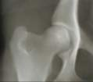




Back to Nature Examples
Generation of Alternatives
Move
Attach
Cling
Spin
Shear
Bend
Adhere
Float
Grip
Cool
Hinge
Separate
Buoy
Encapsulate
Crawl
Nature has spent millions of years refining these phenomena

Slide 71
Affinity Process
Generation of Alternatives
Step 1: As a group brainstorm the problem
Each individual write their ideas on Post-it notes
Then read each one out and stick the Post-it notes on a wall in no particular order
Step 2: In silence each participant groups the ideas into categories /‘affinities’ aligned vertically
No discussion or judgments are cast yet about what is posted
Step 3: Discuss the categories chosen and make any amendments, additions or subtractions
Give each grouping a title or category name and write it on a different color Post-it as a heading
Notes:
DO: Explain the affinity process. Explain that the initial step of writing their own ideas down first is to allow all to contribute effectively. When they call them out and post them on the wall, others can add other ideas during this phase. Don’t go too quickly to miss the inputs. In step 2, stress the grouping in silence first and in step 3 after they have done the first ‘draft’ get them to discuss their groupings and rearrange if necessary, finally naming each grouping on a header Post it. After step 3 when you have the agreed groupings you now may need to use a selection process to decide which ideas to work on.

Slide 72
The Interrelationship Diagram
Generation of Alternatives
A
A
B
4/0
4/0
2/2
D
F
3/1
3/2
F
C
3/2
1/3
B
2/2
C
E
D
1/3
0/5
3/1
E
0/5
Step 1
Step 2
Notes:
SAY: “Make a copy of the headings from the Affinity Process and post in a rough circle on a wall or table. Then start at any heading and draw a line with an arrow to all other headings that are influenced by the heading you are considering. Only use one way arrows. Do not draw a line if it is no influence. Then move the next heading and repeat the process until all headings have been completed.”
DO: Facilitate the process until step 1 is completed. Check for compliance to rules.
SAY: “Next, count how many ‘out’ arrows and how many ‘in’ arrows there are on each heading and write the scores as ‘out/in’ e.g. 3/2 on the Post-it.
DO: Wait until the team(s) have finished this part as some discussion is required to decide if there is a relationship or not. A refinement of the relationships could be a dotted line scores 0.5, a fill line scores 1.0 and a thick line scores 1.5 (Only use this if appropriate).
SAY: “Now arrange the headings vertically (or horizontally) starting with the one with the highest ‘out’s to the one with the lowest ‘out’s. If two headings have equal ‘out’s arrange them side by side or to reflect the relationship order.”
DO: Ask the group to review the relationships between the headings and make any conclusion about the interrelated nature of why problems occur. An example could be - (A) Business is complex, (D) People don’t know what to do (F) People make mistakes (B) Standards not followed (C) No proper training (E) Haven’t got time

Slide 73
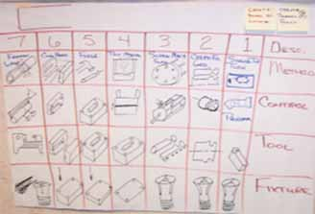
7 Alternatives for Each Function
Generation of Alternatives
Use the brainstorming results from the nature etc. exercise as a source of inspiration to create the 7 Alternatives for each function
Each team member initially draws 7 Alternatives for each function
Why 7? – because 8 is too many and 6 is too few!!!!
Notes:
Why 7? – because 8 is too many and 6 is too few!!!! Answer given by the Shingijutsu Sensei who developed 3P.

Slide 74
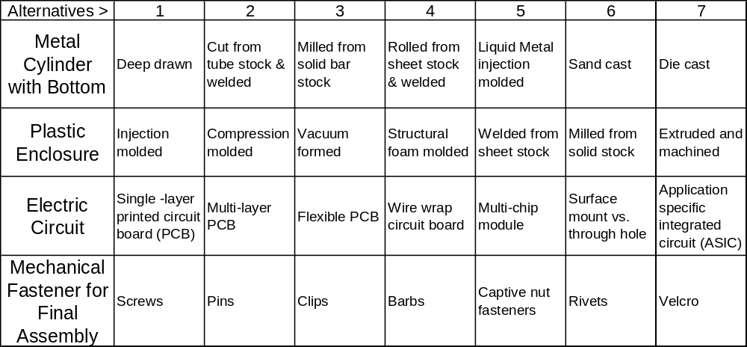
Example of Process Alternatives
Generation of Alternatives

Slide 75
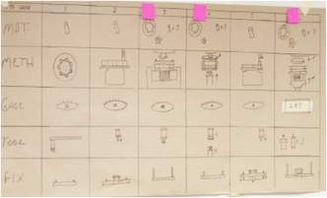
Complete ‘Process At A Glance’ for 7 Alternatives
Generation of Alternatives
Material – value-added step or transformation, “what changes?”
Method – function of the person’s hands, “what do they do?”
Gauge – the device used to ensure 100% quality, “how do we measure”
Tool – actual tool that does the processing, “what makes the product feature?”
Fixture – how the work piece is held, “what holds the part?”

Slide 76
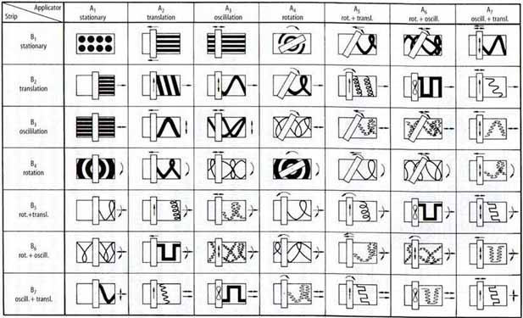
Example of Process Alternatives
(Means of Coating Carpets)
Generation of Alternatives

Slide 77
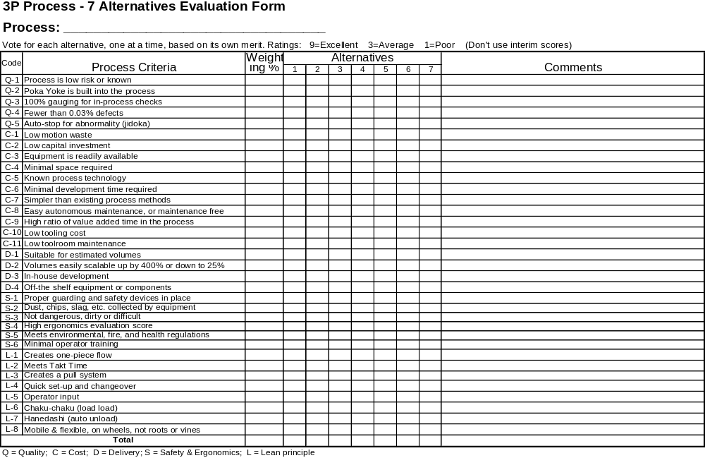
7 Alternatives Form: Process Design
Generation of Alternatives
Notes:
Toyota use checklists as a form of standard operation and as a training aid. This example is a composite extract from Toyota.

Slide 78
Exercise: Paper Airplane Alternatives
Generation of Alternatives
Objective
To design a paper airplane to meet a specification.
Instructions
Time to Complete
Form teams of 3-7 participants.
Each member of the team is to draw at least three alternative designs of a paper airplane that will fly for at least 2 seconds from a height of 5’ (1.5m), uses 1 piece of paper or less, looks aesthetically pleasing and could be manufactured quickly and consistently.
Each team is to select the best three designs using a recognized selection method and construct a prototype of each, test the prototypes against the above criteria and then agree on the final model.
20 minutes
Deliverable
Consensus final design paper airplane
Notes:
SAY: “3P is largely a creative thinking event. Teams are challenged to keep the creative juices flowing as we strive to achieve breakthrough designs and processes. So it is appropriate that we kick the event off with a 3P style creative, team-building exercise. This is a competitive exercise and teams are competing against each other.”
MATERIALS REQUIRED: 1 stopwatch as many sheets of 8.5x11” (or A4) paper per team as required. (Optional: Colored pencils)
DO: Read the instructions aloud with the class on the slide. Have the materials prepared and the tables already assembled to facilitate working in small groups.
DO: Encourage the teams to think about how things in nature achieve flight. Birds, flying squirrels, air borne seeds etc.
DO: Ensure that they follow the 3P process of: i) individual drawn designs, ii) selecting the top three, iii) prototyping and then iv) final selection on the one best solution. Also ensure it is clear that they have 20 minutes in their teams to come up with their final airplane design and test it.
NOTE: Allow the class to come up with their own method for how to determine the best design. Do not be too directive here. Also you may be asked what the criteria for “aesthetically pleasing” is. Just say that “it must look like an airplane or other type of aircraft (no floating flat pieces of paper!)”. Either select a “Customer” or you act as Customer and be the ultimate judge. The Customer can not participate in the team exercises.

Slide 79
Exercise: 7 Alternatives
Generation of Alternatives
Objective
Generate alternative designs.
Instructions
Time to Complete
In the sub-teams, complete the following activities:
Identify Functions and Key Words or principle
Each team member draws 7 alternatives of achieving each key word or principle
Select top 2-3 ideas
Select best method to present to Group
Provided by facilitator
Deliverable
Report out results from creative thinking exercise.
Notes:
SAY: “Why 7? The answer I was given is “because 6 is too few and 8 is too many” from my Japanese Sensei!”

Slide 80
VA/VE Kaizen Event
Charter & Information
Analysis of Current State
Generation of Alternatives
Evaluation of Alternatives
Activity Action Plan
Objectives:
Cost alternatives
Ease / impact matrix
Technical process selection matrix
Pugh selection matrix
Notes:
DO: Review section objectives on slide.

Slide 81

Pen Dot Voting
Evaluation of Alternatives
Marker pen
10 votes each (max 3 votes on any one item)
Tally the votes for a quick, simple way of prioritising the ideas or actions
Ideas / Rank Actions | Votes
Idea 1
Idea 2
Idea 3
Idea 4
2nd
1st
3rd
4th
Notes:
DO: Explain that each participant has a number of votes to share between the ideas that they feel are the best ones. Limit the number of votes per person for any idea to 3. The total number of votes given is typically 10. However if there are a large number of ideas and few delegates this can be increased. A quick formula 5 x Number of Ideas ÷ number of participants will help for unusual situations. Example 20 ideas and 5 participants gives 5 x 20 / 5 = 20 votes each. Limit it a maximum of 20 and a minimum of 5 votes.

Slide 82
Ease/Impact Matrix
Generation of Alternatives
Assess each idea on a scale of low to high based on:
  the potential impact/benefit gained
  the ease/effort required to implement the idea
  other criteria of your choice
Mark your assessment of each idea on the matrix
The better ideas are in the top right of the matrix
High
Med
Low
3
2
6
7
8
Impact
4
1
5
High Med Low
Ease
Notes:
SAY: “This can be done on chart paper or on a wall. The team are to assess where to place the ideas.”

Slide 83
Technical vs Economic Evaluation
Evaluation of Alternatives
Alternatives
Tech Criteria | 1 | 2 | 3 | 4 | 5
Performance | 9 | 3 | 9 | 1 | 3
Quality | 3 | 9 | 3 | 3 | 9
Safety | 9 | 1 | 3 | 1 | 3
Total (27 max) | 21 | 13 | 15 | 5 | 15
Rt = Total/27 | 0.77 | 0.48 | 0.56 | 0.19 | 0.56
1.0
0.75
1
Technical Rating, Rt
3
5
0.5
2
Econ Criteria | 1 | 2 | 3 | 4 | 5
Low cost material | 9 | 3 | 9 | 9 | 9
Low assembly cost | 9 | 1 | 3 | 3 | 3
Low maintenance | 3 | 1 | 1 | 3 | 9
Total (27 max) | 21 | 5 | 13 | 15 | 21
Re = Total/27 | 0.77 | 0.19 | 0.48 | 0.56 | 0.77
0.25
4
0.0
0.0
0.25
0.5
0.75
1.0
Economic Rating, Re

Slide 84
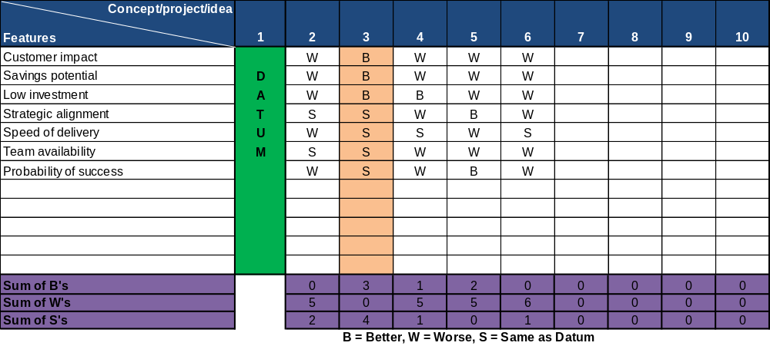
Pugh Matrix
Evaluation of Alternatives
Compare other concepts/ideas and rank others Better, Worse or Same as datum

Slide 85
VA/VE Kaizen Event
Charter & Information
Analysis of Current State
Generation of Alternatives
Evaluation of Alternatives
Activity Action Plan
Objectives:
Alternative refinement
Decision action planning
Timing plan for Design, Qualification and Ramp-up phases
Resource plan for next phases
Prepare report-out
Deliver report-out
Notes:
DO: Review section objectives on slide.

Slide 86
Prepare Key Elements for Next Phases
Activity Action Plan
Design Phase
  Design
  Test samples
Qualification
  Internal verification
  Customer verification
Implementation
  Ramp-up plans
  Documentation
  Phase out of old inventory
  Monitor savings

Slide 87
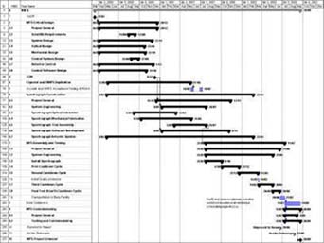
Create Project Plan for the Next Phases
Activity Action Plan
Develop Work Breakdown Structure
Estimate effort (direct work), duration (lapse time)
Resource list and availability
Sequence
Dependencies
Track deliverables & costs

Slide 88
Prepare Final Report Out and Budget
Activity Action Plan
Objective
To prepare the management report-out presentation.
Instructions
Time to Complete
Develop a project report-out presentation to include:
Charter
Objectives
Proposals
Implementation Plan
Benefits Summary
Provided by facilitator
Deliverable
Report out presentation

Slide 89
Other Modules In This Series:
5S
Standard Work
Total Productive Maintenance (TPM)
Administrative Lean
Cell Design/ Production Preparation Process (3P)
Kaizen
Kanban
Problem Solving
Poka Yoke Quality Systems
Transaction Process Improvement (TPI)
Cause & Effect Diagram with the Additions of Cards (CEDAC)
Single Minute Exchange of Dies (SMED)
Value Stream Mapping (VSMi®)
Visual Management
Managing Daily Process Excellence
For More Information Please Contact:
Mark DeLuzio, President and CEO
+1.860.234.0915
mark.deluzio@leanhorizons.com
Strategically Creating Value Through the Elimination of Waste

